Slide 1

Beyond QWERTY:
Form Filling
with AI-Powered Voice
Recognition
An AI-Intensive Project Transforming Traditional Data Entry
Presented by Rishiraj Yadav, Intern at Infosys AI Springboard, Batch 2

Slide 2

Project Overview: Voice-Based Form Filling
Objective
Problem
Replace manual text entry with AI-powered voice recognition for efficient, hands-free form filling.
Manual forms are slow, error-prone, and difficult for people with accessibility needs. They require typing and can be challenging for non-native speakers or those with physical disabilities.
The voice-based form-filling system replaces manual forms, allowing users to fill out forms with voice commands. It reduces errors, overcomes language barriers, and ensures accuracy with real-time validation and secure data storage.

Slide 3
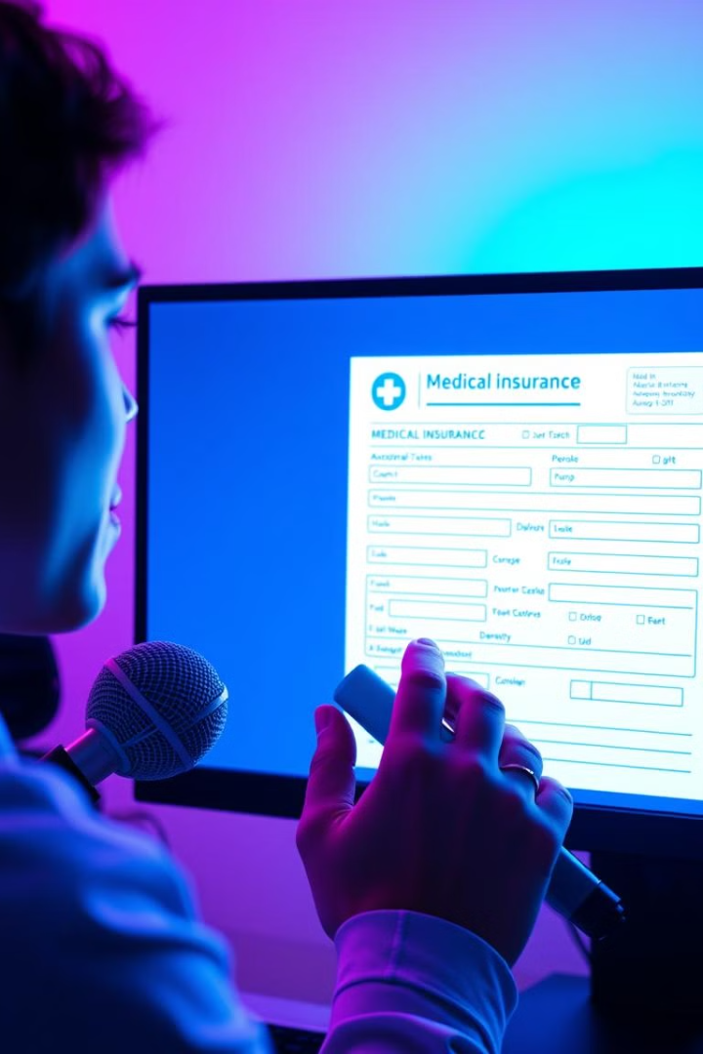



Introducing Voice Recognition Technology
Speech-to-Text
Our solution uses AI-powered voice technology, letting users speak their information instead of typing it.
Automated Data Entry
The system translates spoken words into text, automatically populating form fields.
Accuracy and Efficiency
This streamlines the process, reduces errors, and significantly improves efficiency.

Slide 4

AI-Powered Voice-Based Form Filling: Key Features
Speech Recognition
1
Our system uses the WebkitSpeechRecognition API to process and understand spoken language.
Natural Language Processing
2
It utilizes NLP to interpret the meaning of user's speech, extracting relevant data.
Form Validation
3
The system makes sure that the data entered is correct and follows the required format of the form.
PDF Generation
4
The filled form is automatically generated as a PDF, ready for
submission.

Slide 5

Impact on Productivity and
Efficiency
30%
Time Savings
Significantly reduces the time required to complete forms, boosting productivity.
80%
Error Reduction
Minimizes data entry errors, leading to fewer corrections and rework.
95%
User Satisfaction
Enhances user experience by simplifying the process and reducing frustration.

Slide 6

Workflow Structure
User Authentication
1
Users log in to the platform with their credentials or
create an account.
2
3
4
5
Form Navigation
Users select the desired form from a list or by searching
for specific terms.
Voice Input
Users speak their information, which is captured by the
voice recognition engine.
Translation and Validation
The system translates spoken words into text, validating
the data for accuracy.
PDF Generation
A PDF of the filled form is generated and made available
for download or submission.

Slide 7

Challenges & Solutions
Challenge 1
Handling speech recognition accuracy in noisy environments.
Solution
Implement noise cancellation algorithms.
Challenge 2
Managing multilingual inputs.
Solution
Robust integration with Google Translate API.
Challenge 3
Dynamic PDF creation with complex forms.
Solution
Use ReportLab library for scalable PDF generation.

Slide 8
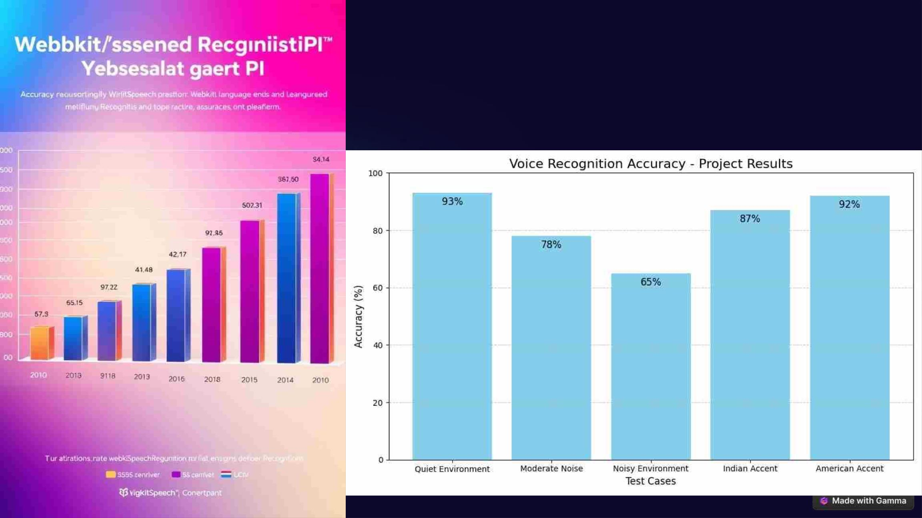
Key Findings: Recognition
Accuracy Rates

Slide 9
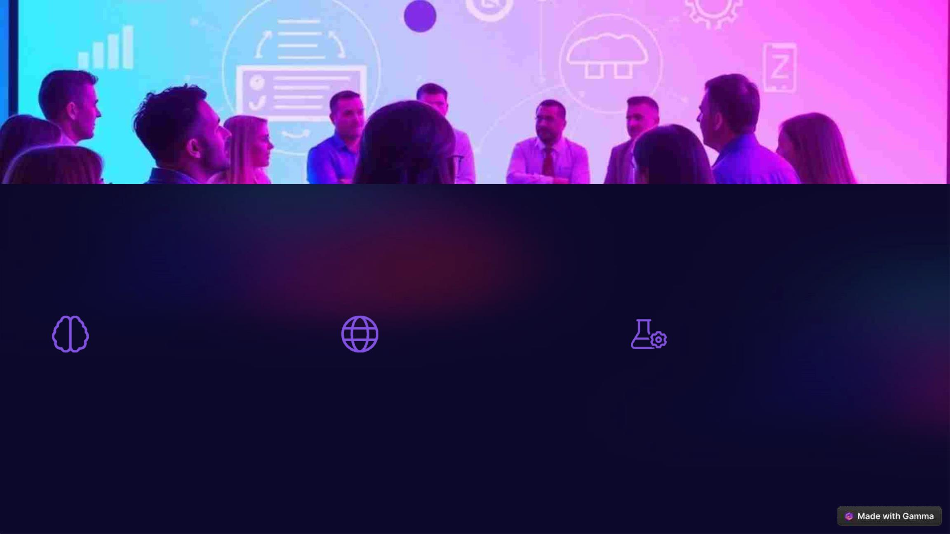
Future Improvements and Next Steps
Adaptive Learning
Multilingual Support
Personalized Settings
Continued development of AI-powered
models to improve recognition accuracy
over time.
Expanding support for a wider range of
languages to cater to diverse user
populations.
Allowing users to adjust settings like
accent and noise cancellation to optimize
accuracy.

Slide 10
The Benefits of Voice-Driven Form Filling
Increased Speed and
Efficiency
Enhanced Accessibility
Reduced Errors and
Improved Accuracy
For individuals with disabilities, voice
input can be a game changer, providing
an alternative to traditional keyboard and
mouse interactions, making forms more
accessible and inclusive.
Voice form filling allows users to input
data quickly and effortlessly, eliminating
the need for manual typing and reducing
errors. This translates to significant time
savings and a more efficient workflow.
By minimizing manual data entry, voice
form filling significantly reduces the risk
of typos and mistakes, leading to
improved data quality and reliability.

Slide 11
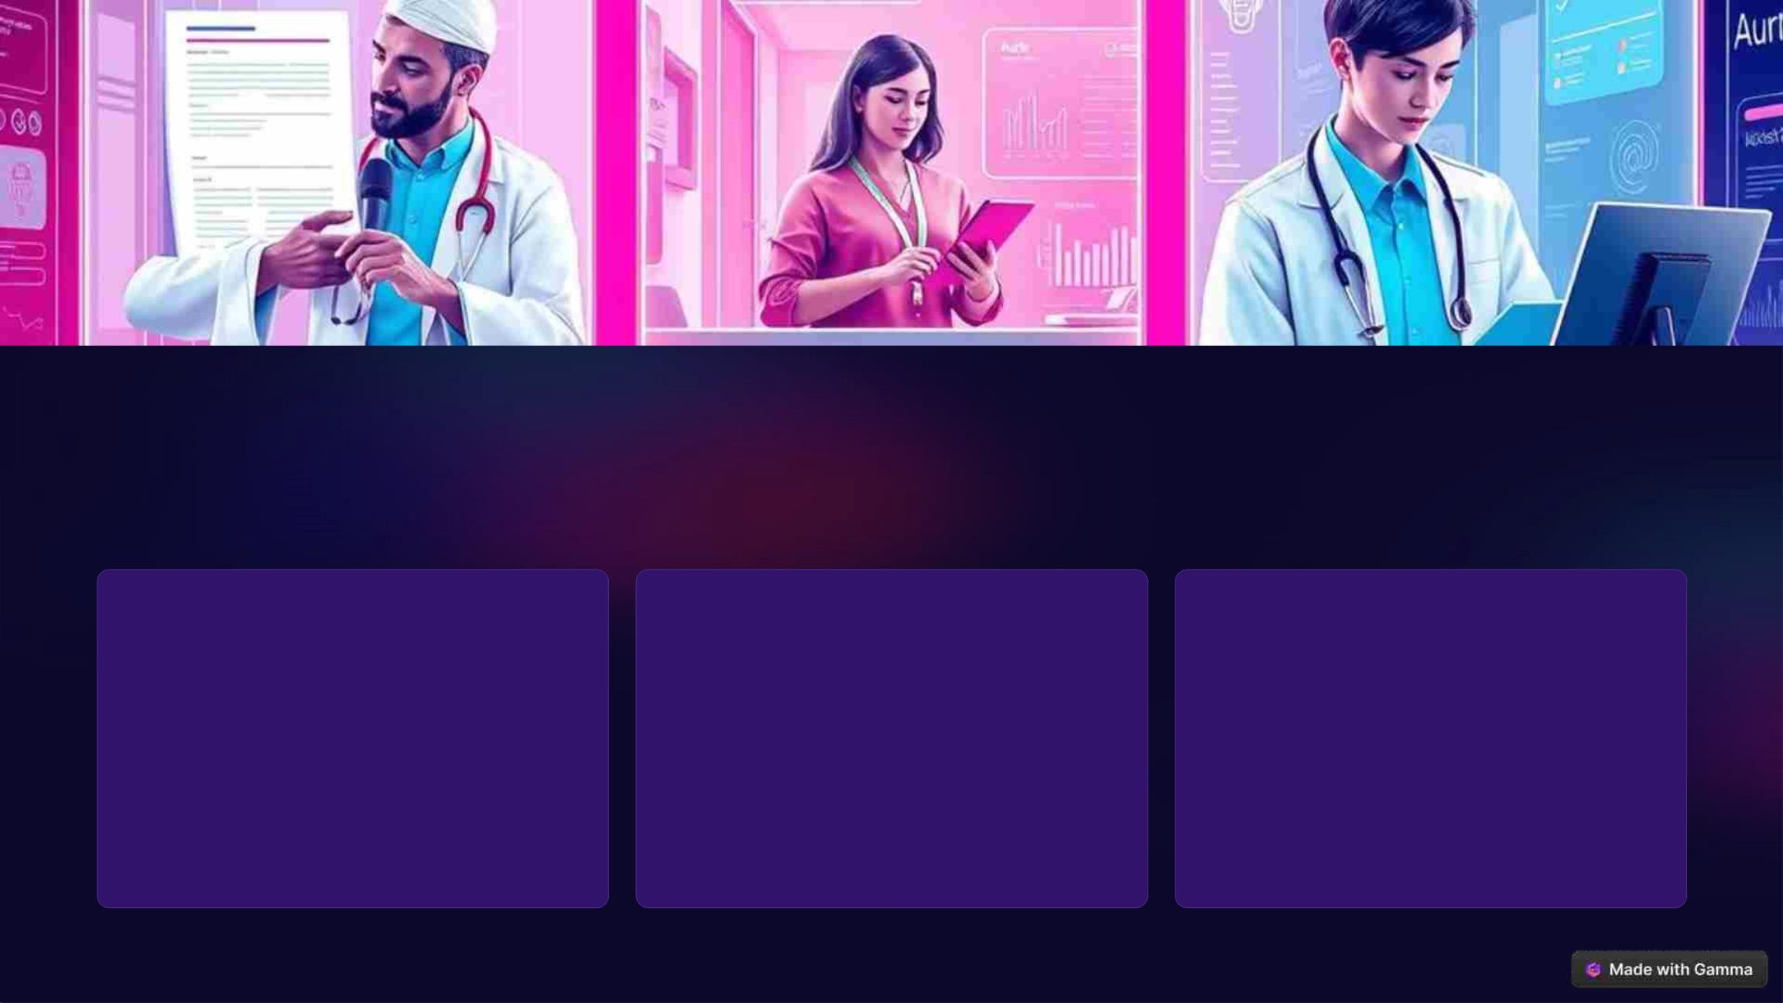
Real-World Use Cases and Applications
Healthcare
Customer Service
Education
Doctors and nurses can use voice
form filling to document patient
information and prescriptions more
efficiently, streamlining patient care.
Customer service representatives can
quickly capture customer details and
requests using voice input, improving
customer satisfaction and resolving
issues faster.
Students can utilize voice form filling
to complete assignments and
surveys, freeing up time for learning
and research.

Slide 12

Conclusion
Voice form filling presents a transformative approach to data collection, offering a seamless, accessible, and secure method for user interaction.

Slide 13
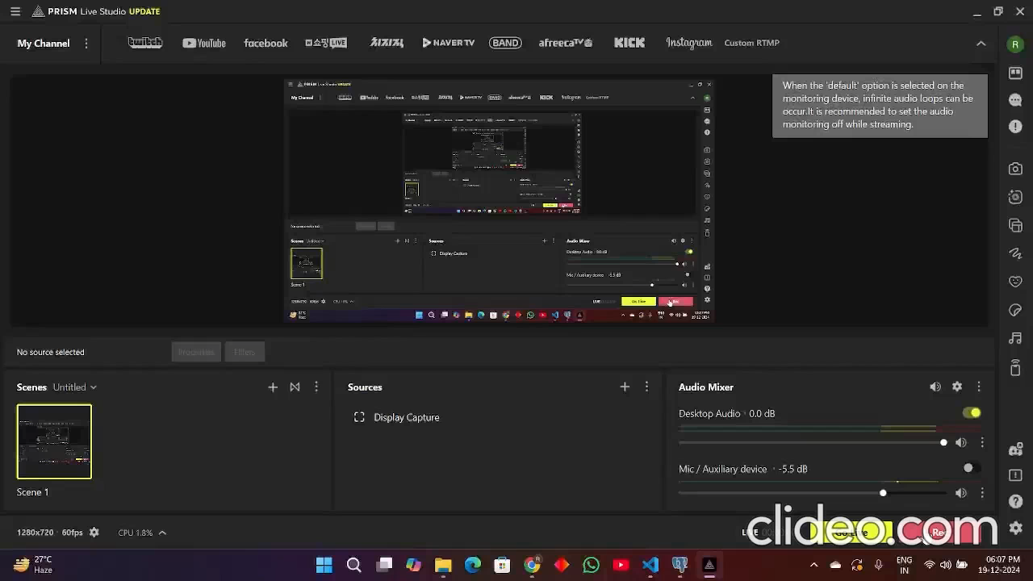
Demo Video Of the Project

